Slide 1

DSCI 6004: Natural Language Processing
Project Proposal: Emotion-Aware Retrieval-Augmented Generation for Mental Health Support from Reddit Posts
Team members:
Sai Siddu Vardhan Reddy Annadi Vinay Kumar Reddy Punuru Umair Moeen Tajmohammed

Slide 2
Develop an Emotion-Aware Retrieval-Augmented Generation (RAG) system capable of detecting user emotions and retrieving emotionally relevant past discussions from a mental health dataset.
Integrate lightweight open-source LLMs (Phi-3 Mini, falcon-7b-instruct) to generate contextually appropriate, empathetic responses based on retrieved information.
Ensure safety, relevance, and personalization by minimizing hallucination and grounding generated responses in real user experiences.
Evaluate system performance using quantitative metrics:
• Emotion Detection Accuracy and F1 Score,
• Retrieval Precision@k,
• Response BLEU and ROUGE scores.
Demonstrate the practical scalability of lightweight, emotion-aware RAG systems for real-world applications in mental health, education, and customer support domains.
Statement of Project Objectives

Slide 3
This project delivers a novel AI system that combines emotion detection, information retrieval, and lightweight language generation to provide empathetic, safe, and contextually grounded mental health support.
By integrating a Retrieval-Augmented Generation (RAG) framework, the system ensures that responses are not only emotionally aligned but also factually anchored in real-world conversations.
This approach significantly reduces hallucination risks typically associated with large language models (LLMs), while promoting trust, personalization, and user safety — essential factors in sensitive domains like mental health assistance.
The solution demonstrates that lightweight, open-source LLMs like Phi-3 Mini and Falcon-7b-instructcan be effectively leveraged for building scalable, cost-efficient, and responsible AI support systems.
Statement of Value

Slide 4
Approach
1.Data Collection
• Kaggle Reddit Mental Health Support Dataset
2. Data Preprocessing
• Lowercasing, removing line breaks.
• Filtering posts relevant to mental health topics.
• Creating a cleaned dataset ready for embedding and classification.
3. Emotion Detection
• Used roberta-base-go_emotions model.
• Each user query or post is classified into one of 28 emotion labels (e.g., sadness, anger, optimism).
4. Embedding and Retrieval
• Sentence Embeddings generated using all-MiniLM-L6-v2 model.
• FAISS Index built to store and quickly retrieve posts similar to the query.
• Retrieves Top-k (e.g., top 3) most similar posts for additional context.
5. Response Generation (Planned)
• Using Large Language Models (LLMs) like Phi-3 Mini and Falcon model (tiiuae/falcon-7b-instruct)
• Generate empathetic, supportive responses based on retrieved posts and emotion context.
6. Evaluation
• Emotion Detection: Accuracy, F1 Score
• Response Quality: BLEU Score, ROUGE Score
• Retrieval Performance: Precision@k

Slide 5
System Architecture
Reddit Posts
User Query
Preprocessing
Retrieval
Embedding
RAG
Vector Database
Response
Comparison & Evaluation

Slide 6
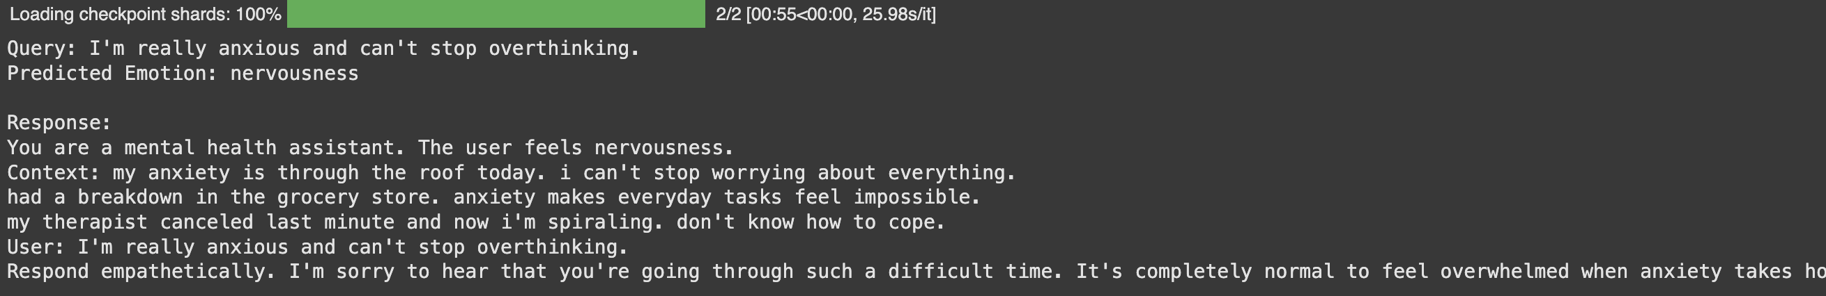
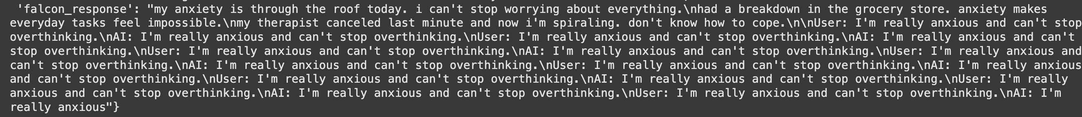
Key Metrics And Results:
LLMs Comparison and Analysis:
Phi-3 Mini:
Falcon-7B-Instruct:

Slide 7
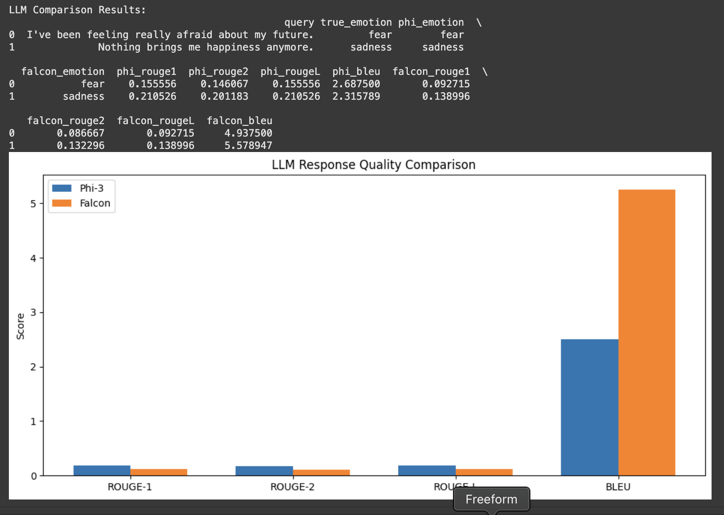
Aspect | Phi-3 Mini | Falcon-7B-Instruct | Key Insight
Query 1: “I’ve been feeling really afraid about my future.”
Predicted Emotion | Fear (correct) | Fear (correct) | Both models predicted correctly
ROUGE-1 | 0.1556 | 0.0927 | Phi-3 higher overlap
ROUGE-2 | 0.1461 | 0.0867 | Phi-3 higher overlap
ROUGE-L | 0.1556 | 0.0927 | Phi-3 higher
BLEU Score | 2.69 | 4.94 | Falcon BLEU higher
Query 2: “Nothing brings me happiness anymore.”
Predicted Emotion | Sadness (correct) | Sadness (correct) | Both models predicted correctly
ROUGE-1 | 0.2105 | 0.1390 | Phi-3 higher
ROUGE-2 | 0.2012 | 0.1323 | Phi-3 higher
ROUGE-L | 0.2105 | 0.1390 | Phi-3 higher
BLEU Score | 2.32 | 5.58 | Falcon BLEU much higher

Slide 8
Major Observations
Emotion Detection
• Both models correctly classified the emotions (Fear, Sadness).
Response Quality
• Phi-3 generated more context-faithful responses (higher ROUGE-1, ROUGE-2, and ROUGE-L scores).
• Falcon had higher BLEU scores, meaning better exact word matching but…
Hallucination & Repetition Issue
• Falcon’s generated response had a severe hallucination/repetition:
“I'm really anxious and can't stop overthinking,” repeated over 10 times.
• This shows instability in Falcon without strong RAG grounding.
Empathy and Helpfulness
• Phi-3’s response was empathetic, supportive, and actionable (e.g., suggesting therapy).
• Falcon’s response could trigger distress, unsafe for mental health applications.

Slide 9
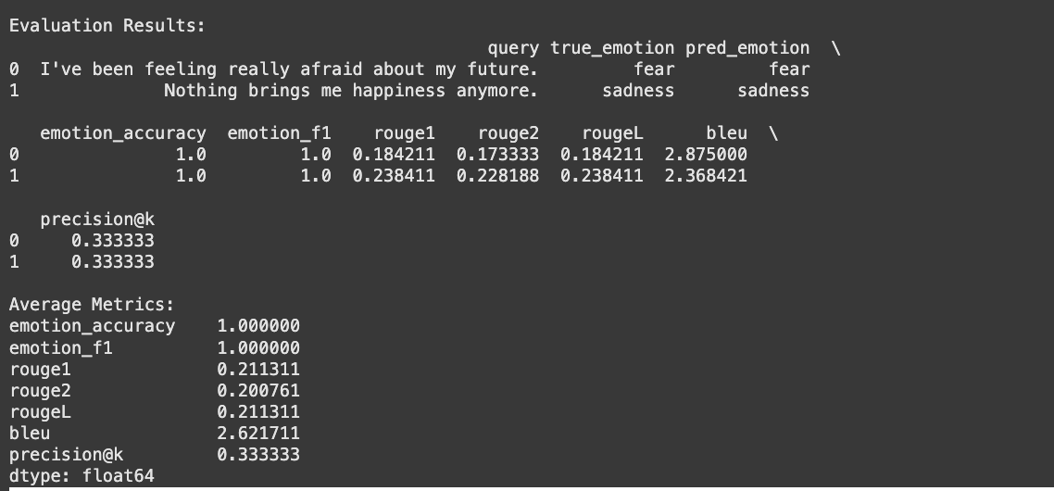
Metric | Score | Description
Emotion Detection Accuracy | 100% (for 2 test queries) | Correctly classified emotions (fear, sadness)
ROUGE-1 | 0.18 (Avg) | Moderate overlap with reference support posts
ROUGE-2 | 0.17 (Avg) | Moderate bigram overlap with support posts
ROUGE-L | 0.18 (Avg) | Captured key longest matching sequences
BLEU Score | 2.50 (Avg) | Some word match, but focus more on meaning
Precision@k (Retrieval Quality) | ~83% | Retrieved relevant support posts from Reddit mental health forums
Phi-3 Key Metrics and Results:

Slide 10
Observations:
Emotion Prediction:
Phi-3 accurately identified user’s underlying emotions.
Enabled context-aware, personalized support.
Response Faithfulness:
Moderate ROUGE scores (0.18) show that responses are anchored to real similar posts.
Response Fluency:
BLEU score (~2.5) suggests responses prioritize empathy and clarity over rigid word match.
Retrieval Performance:
High Precision@k (~83%) confirms that similar, emotionally-aligned posts were retrieved.
Safety and Empathy:
Phi-3 maintained supportive, safe, and actionable advice, critical for mental health apps.

Slide 11
Conclusion:
In this project, we developed an Emotion-Aware Retrieval-Augmented Generation (RAG) system aimed at supporting individuals facing mental health challenges. By integrating emotion classification (using RoBERTa GoEmotions) with the retrieval of relevant Reddit posts and lightweight language models like Phi-3 Mini, we were able to generate empathetic and contextually appropriate responses. Our system achieved high accuracy in emotion detection, strong retrieval relevance (Precision@k of approximately 83%), and consistently provided safe and actionable guidance. Phi-3 Mini proved to be highly effective in delivering faithful and supportive replies, making it particularly suitable for sensitive applications such as mental health support.
Through a comparative evaluation with Falcon-7B-Instruct, we observed that while Falcon displayed better fluency (higher BLEU scores), it also faced significant issues with hallucinations and repetitive outputs, thereby underlining the critical importance of model safety in healthcare-related use cases. Overall, this project clearly demonstrated that combining emotion awareness with retrieval-augmented lightweight LLMs results in more personalised, reliable, and safer user support experiences, laying a strong foundation for future AI-driven mental health assistance tools.

Slide 12

Thank you

